Slide 1



















Avatars scenario library Outdoors
DECEMBER 2021

Slide 2












Trees

Slide 3




















Trees

Slide 4




Bushes

Slide 5










Mountains and Hills

Slide 6















Mountains and Sand Dunes

Slide 7


Clouds

Slide 8
Stars

Slide 9

Example background scene

Slide 10


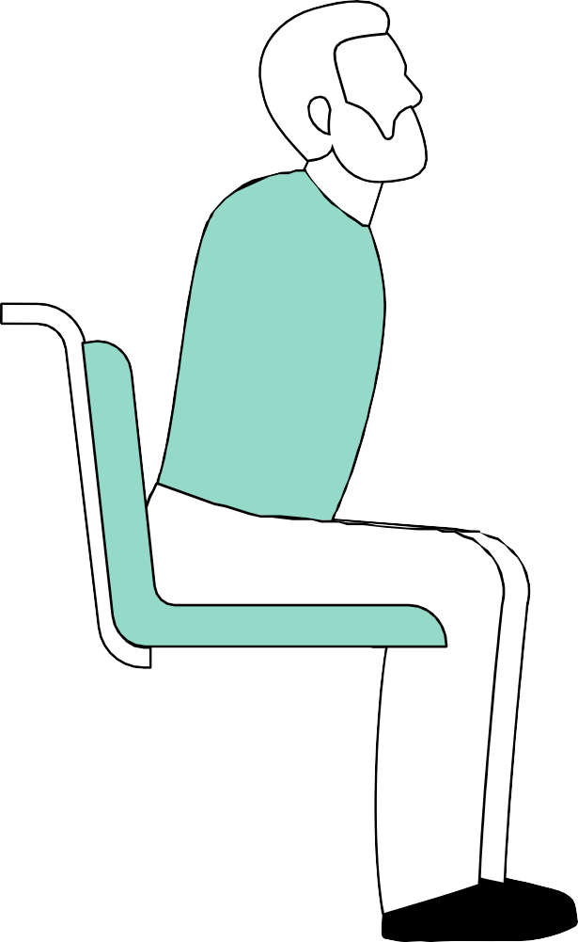



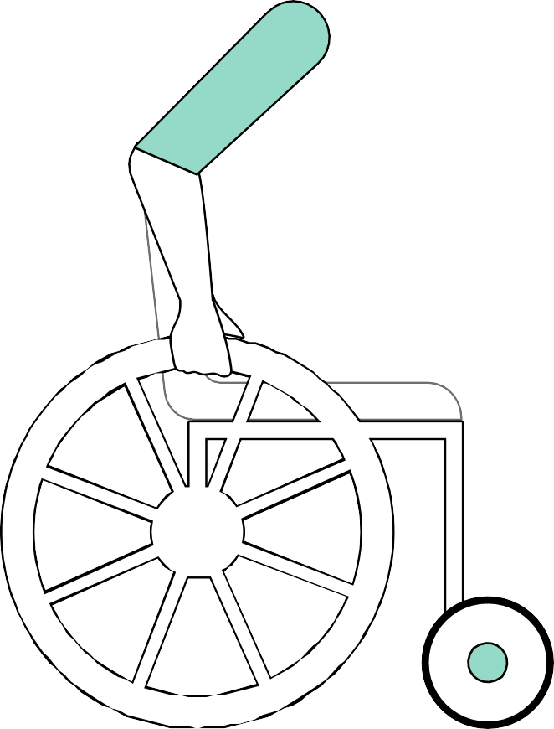











Example background scene

Slide 11

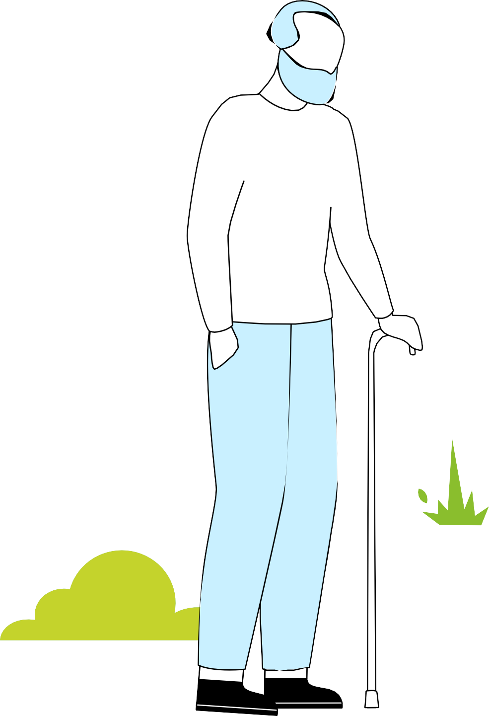
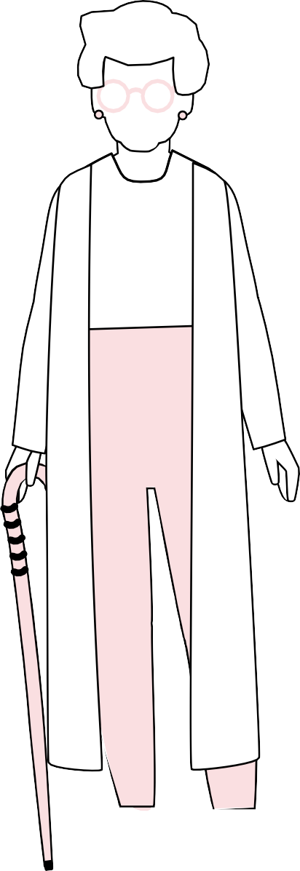






Example background scene

Slide 12




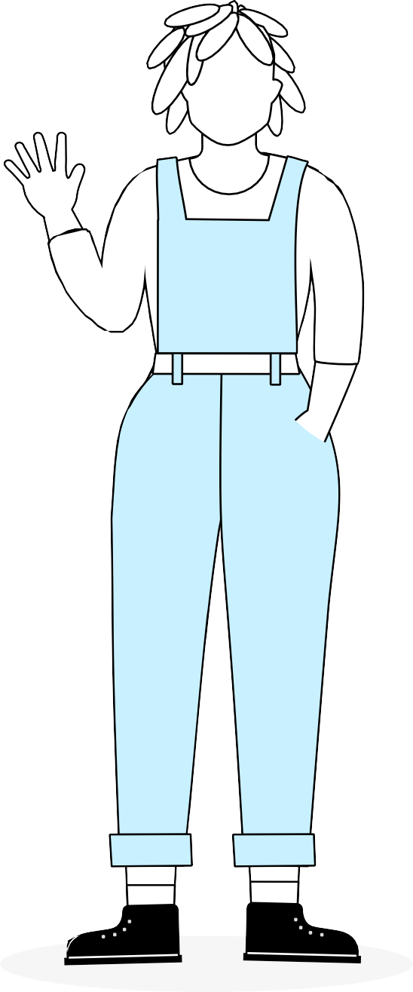

Example background scene

Slide 13



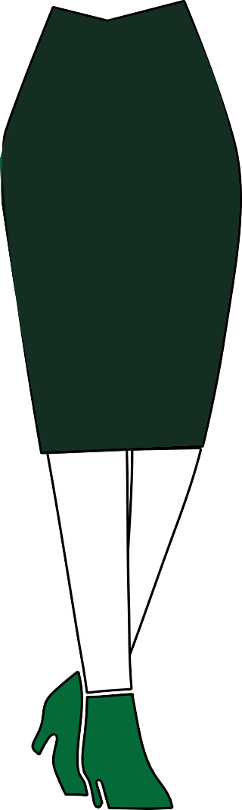



Example background scene

Slide 14





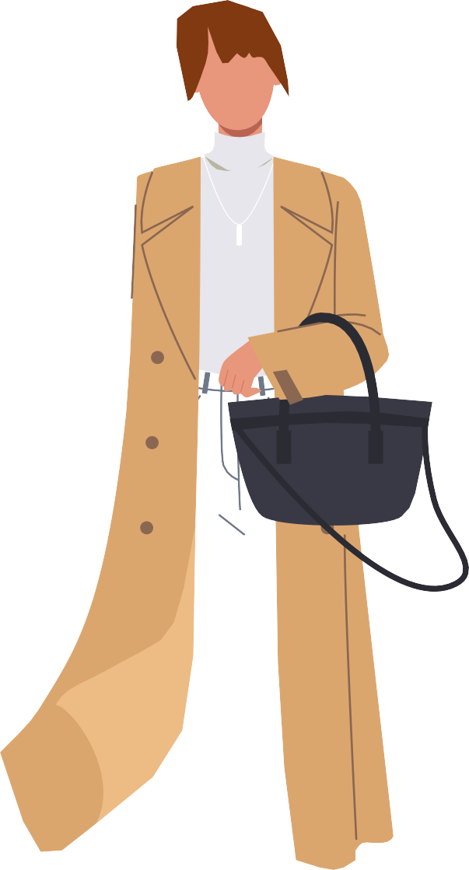



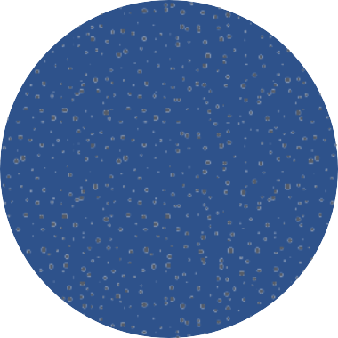






Example background scene

Slide 15

Deloitte refers to one or more of Deloitte Touche Tohmatsu Limited
(collectively, the “Deloitte organization”). DTTL (also referred to as “Deloitte separate and independent entities, which cannot obligate or bind each related entity is liable only for its own acts and omissions, and not those
of each other. DTTL does not provide services to clients. Please see www. deloitte.com/about to learn more.
© 2021. For information, contact Deloitte Touche Tohmatsu Limited.

